Slide 1
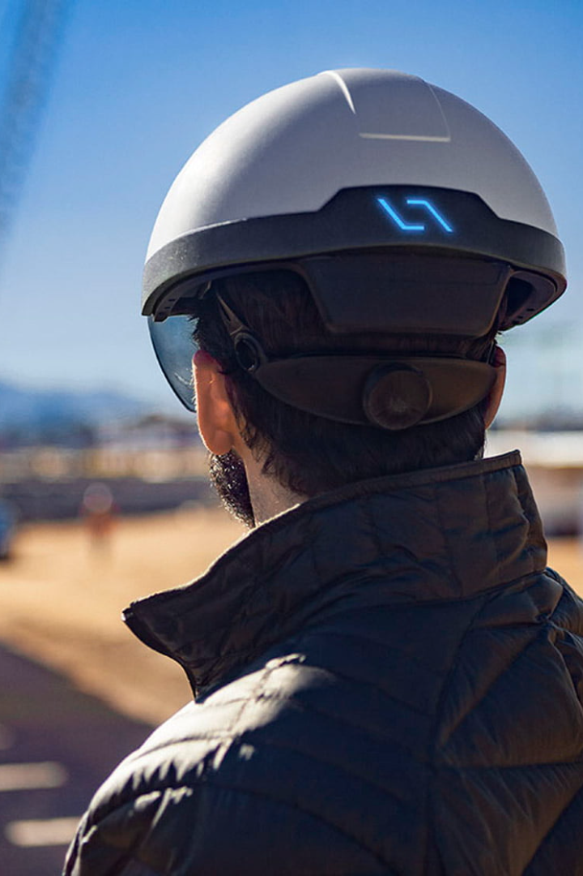
IoT Based Smart Helmet for Industrial Workers
This presentation introduces an IoT-based smart helmet designed for industrial workers. Explore the purpose, components, working, benefits, challenges, and future possibilities of this innovative project.

Slide 2

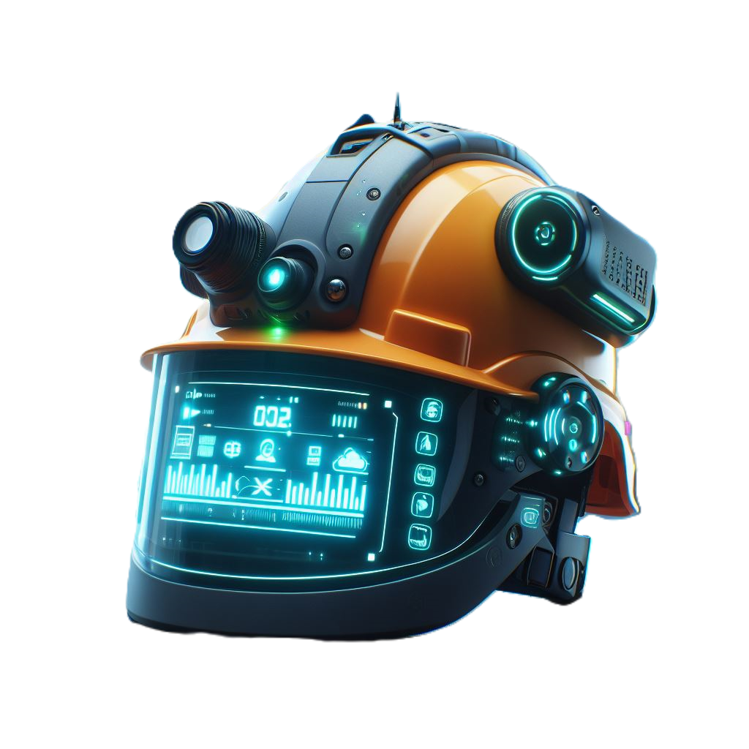
Team Member:
Raviraj Kumar (20-ECE-123)
Ranjeet Abhigyan (20-ECE-118)
Ranjeet Kumar (20-ECE-119)
Ravi Ranjan (20-ECE-121)
Raushan Singh (20-ECE-120)
Guided By: Dr. Kushal Roy

Slide 3
Introduction
The IoT base smart helmet for industrial workers is a revolutionary device designed to enhance safety and improve efficiency in industrial environments. This advanced helmet is equipped with various sensors that monitor critical parameters such as temperature, gas leakage, humidity, fall/crashes, and pulse. By continuously monitoring these parameters, the smart helmet ensures the well-being of workers and provides early warnings in case of any potential hazards

Slide 4
Key Features
Temperature Monitoring: The helmet is equipped with a temperature sensor to monitor the ambient temperature and alert workers of extreme conditions.
Gas Level Detection: It also features a gas sensor to detect the presence of harmful gases in the environment and provide timely warnings to workers.
Radiation Monitoring: The helmet is equipped with a radiation sensor to monitor radiation levels and ensure worker safety in radioactive environments.
Humidity Measurement: It includes a humidity sensor to monitor the moisture levels in the environment and prevent discomfort or health issues for workers.
Fall/Crash Detection: The helmet is equipped with a fall/crash sensor to detect sudden impacts or falls and send alerts for immediate assistance.
Pulse Monitoring: It also features a pulse sensor to monitor the heart rate of workers and detect any abnormalities or signs of stress.

Slide 5
Components of the Smart Helmet
Arduino UNO
Buzzer
Microcontroller board used as the brain of the smart helmet.
Audio alarm used to alert the worker in case of emergencies.
ESP 8366
Temperature Sensor
Wi-Fi module for wireless communication and data transfer.
Measures the ambient temperature to monitor worker comfort and safety.

Slide 6
Gas Sensor
Radiation Sensor
Detects the presence of harmful gases in the environment to prevent inhalation hazards.
Monitors radiation levels to protect workers from exposure to harmful radiation.
Humidity Sensor
Fall/Crash Sensor
Measures the humidity level to ensure worker comfort and prevent moisture-related issues.
Detects sudden falls or impacts to trigger emergency alerts and assistance.
Pulse Sensor
Monitors the worker's heart rate to detect any abnormalities or signs of distress.

Slide 7
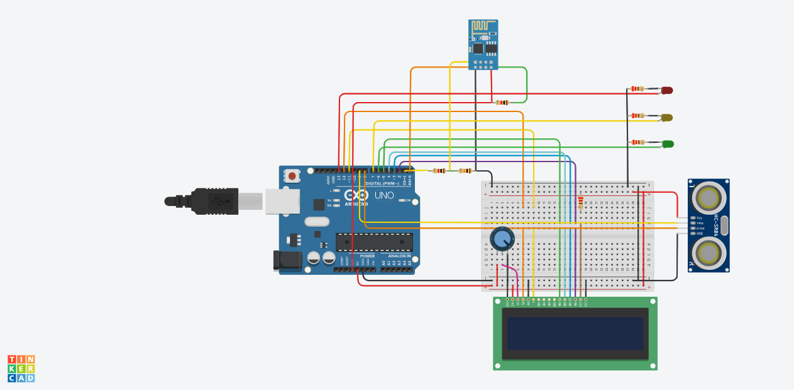
B
Block Diagram

Slide 8
IoT Integration
Real-Time Monitoring
Data Transmission to the Cloud
Cloud-Based Storage
Remote Access for Supervisors
Connecting our Smart Helmet to the Internet for enhanced safety and communication.

Slide 9
Working of the Smart Helmet
1
Data Collection from Various Sensors
The smart helmet is equipped with various sensors that continuously monitor the worker's environment.
2
Processing and Sending Data to the Cloud
The data collected by the sensors is sent to a central system for analysis and alerts.
3
Real-time Monitoring and Analysis
In case of any danger or hazardous situation, the smart helmet is equipped with an alarm system to notify the worker.

Slide 10
Benefits of the Smart Helmet
1
Improved Safety for Industrial Workers
Learn how the smart helmet enhances worker safety and reduces workplace accidents.
2
Early Detection of Hazardous Conditions
Understand how the helmet's sensors enable early detection of dangerous environments.
3
Enhanced Communication and Prompt Response
Discover how the helmet facilitates effective communication and quicker response times during emergencies.

Slide 11
Challenges and Limitations
1
Integration and Compatibility Issues
Discuss the challenges related to integrating and ensuring compatibility between different components of the smart helmet.
2
Power Consumption and Battery Life
Explore the limitations caused by power consumption and the need for long-lasting battery solutions.
3
Accuracy and Reliability of Sensor Data
Understand the challenges associated with maintaining the accuracy and reliability of sensor data in various working conditions.

Slide 12
Future Enhancements
Upgrading Sensors for Increased Accuracy
Integrating Machine Learning for Predictive Analysis
Collaborating with Industry Experts for Continuous Improvement
Expanding IoT Capabilities for Broader Applications

Slide 13
Conclusion
The IoT based smart helmet for industrial workers is a groundbreaking solution that prioritizes the safety and well-being of workers.
By providing real-time monitoring of various environmental factors and the worker's health, the smart helmet ensures a safer working environment.
With the ability to detect and alert workers about hazardous conditions, such as high temperature, toxic gases, and low oxygen levels, the smart helmet significantly reduces the risk of accidents and injuries.
Furthermore, the integration of GPS tracking and emergency response features enhances the overall safety measures for workers, enabling quick assistance in case of emergencies.
Overall, the IoT based smart helmet is a game-changer in industrial safety, providing real-time monitoring, early detection of potential hazards, and ensuring the well-being of workers.

Slide 14

Thank You

